Slide 1
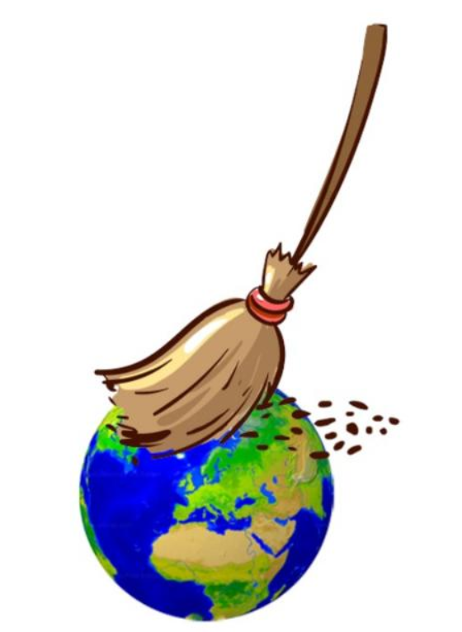
INTRODUCTION
Company name:. Kṛṣṇa-A Cleanliness Drive
Vision :: To clean India by 2035. & after that expand worldwide.
Field : Waste Management

Slide 2
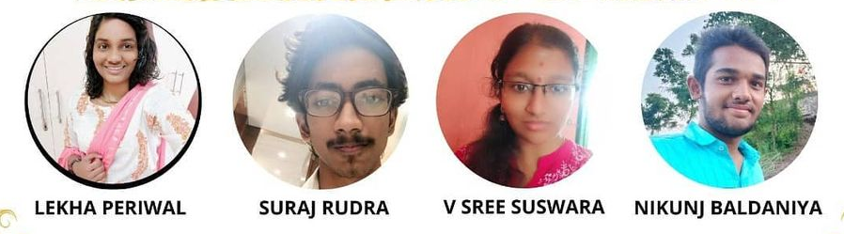
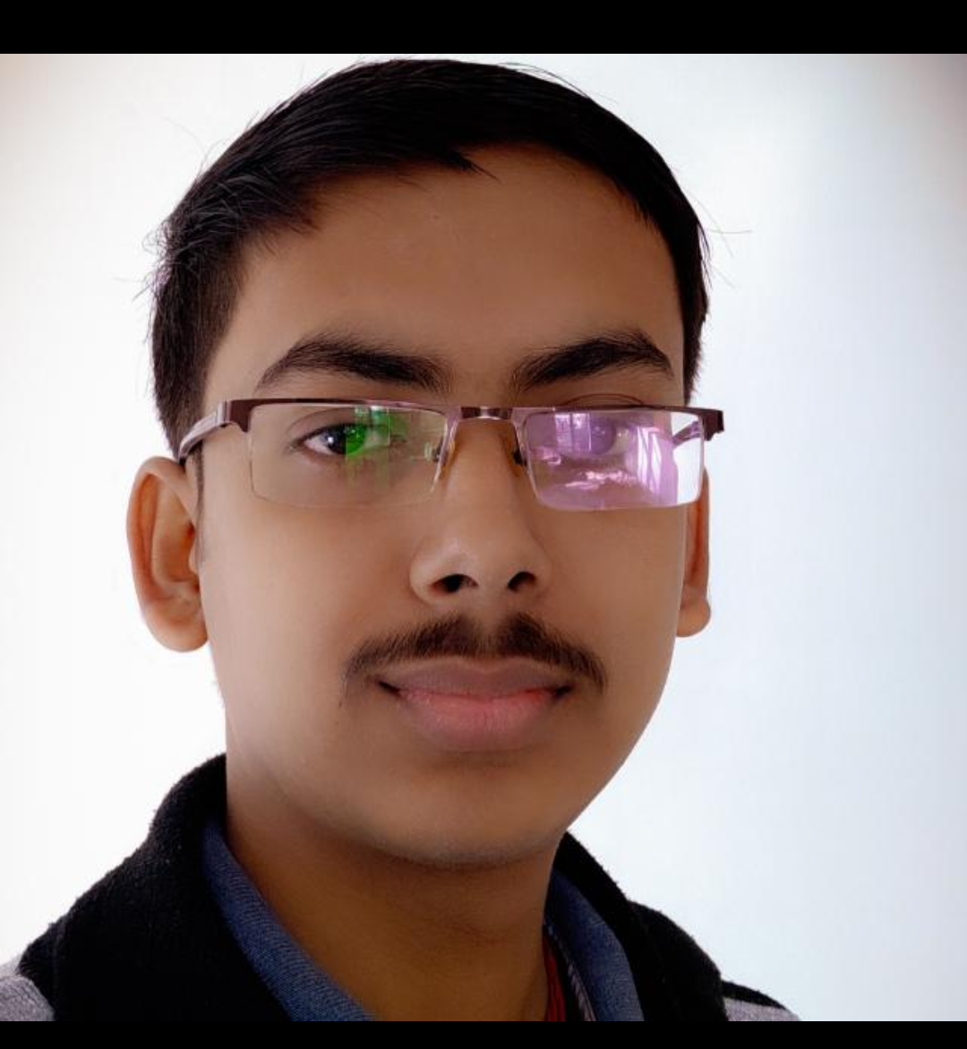
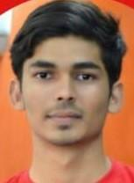
Management team

Slide 3
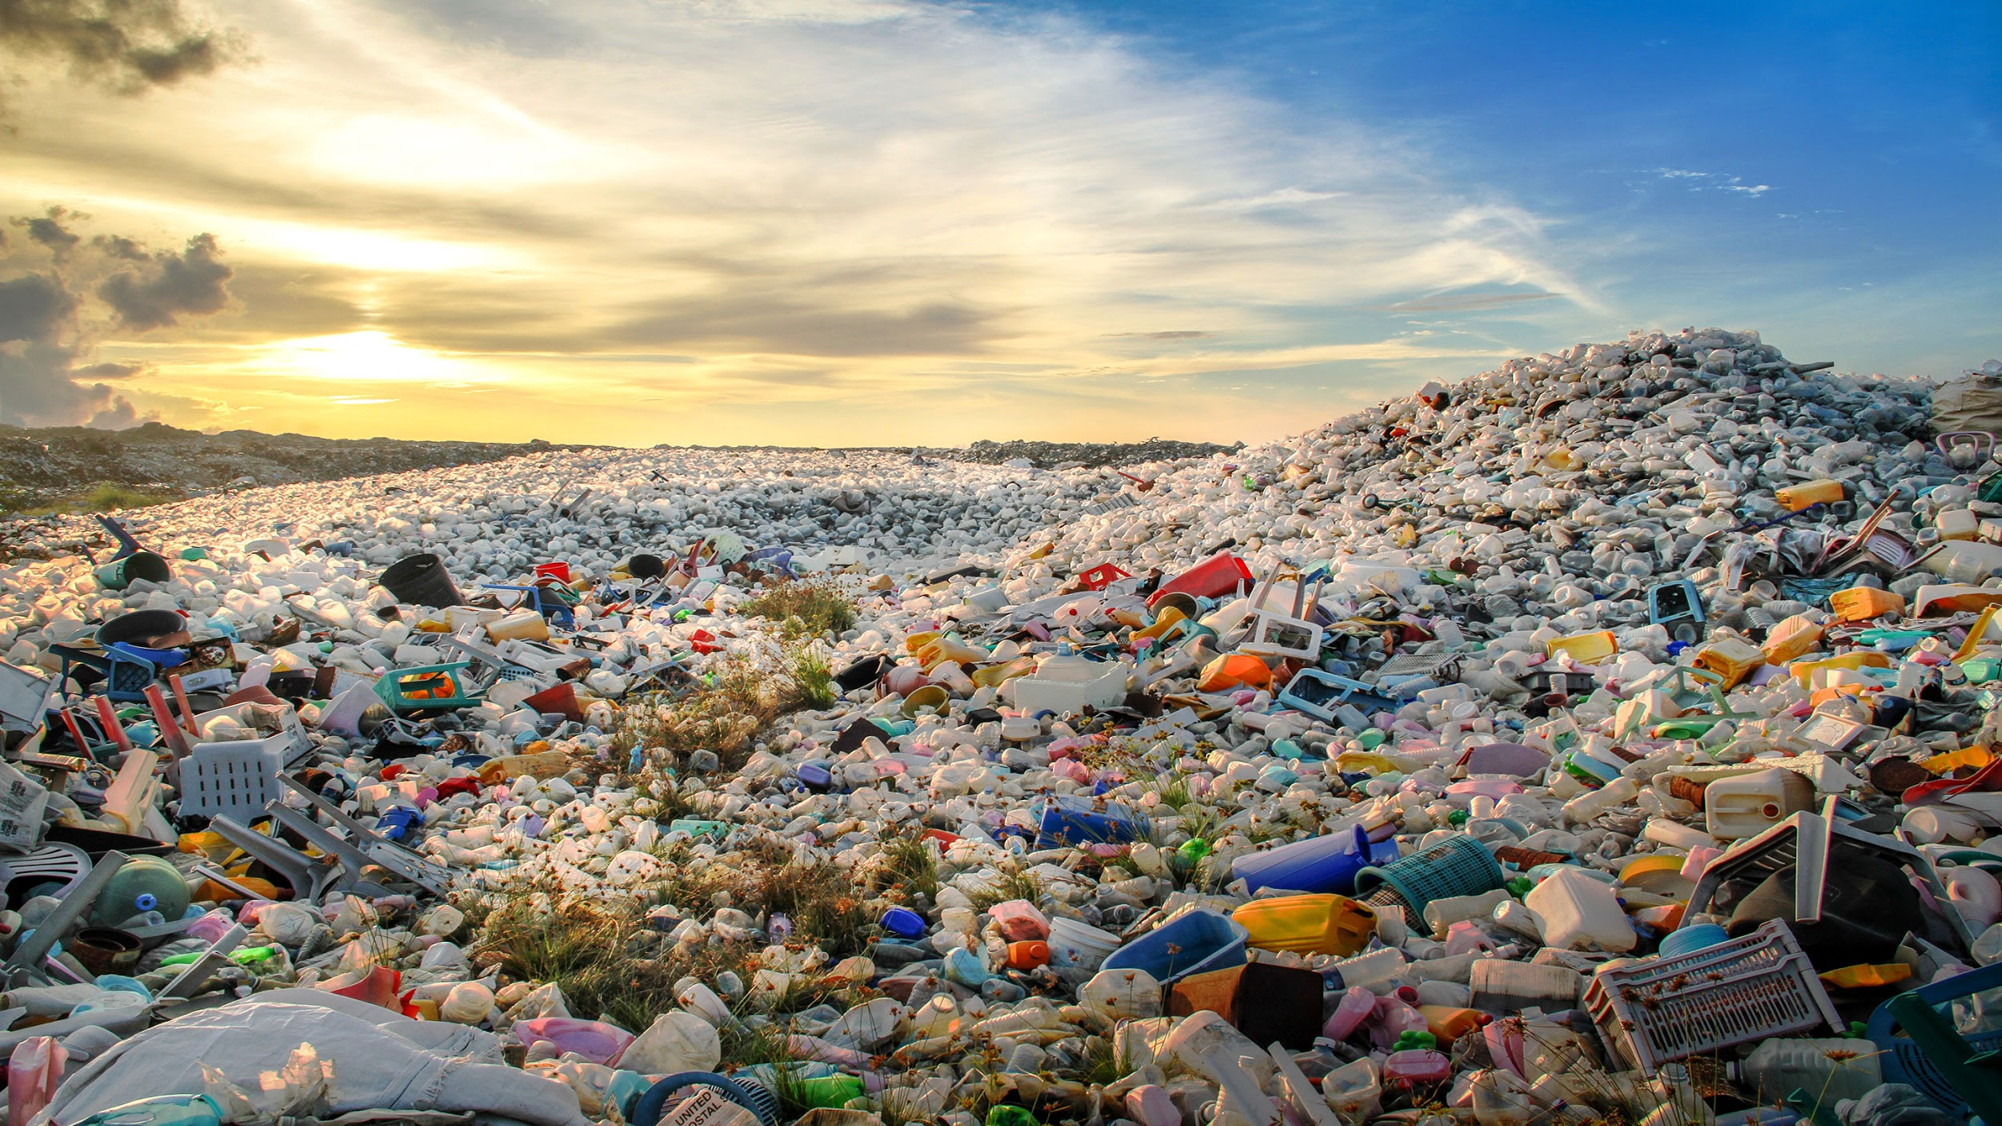
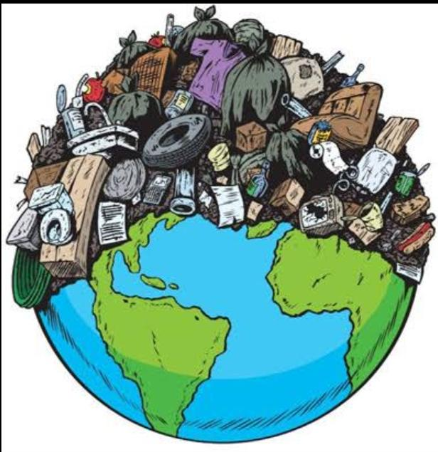
PROBLEM STATEMENT
• Scattered waste in public places (roads,parks,etc)
• Lack of proper segregation of wastes in already existing system.

Slide 4
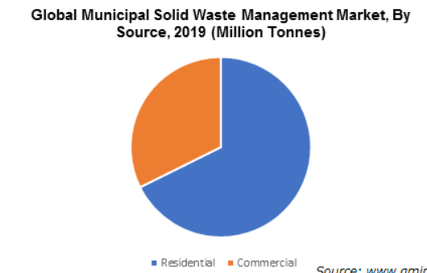
Total Addressable Market
Customer Analysis
Customer Acquisition strategy | Viral Marketing through Rewards
Customer Loyalty program | In addition to having a detailed FAQ section on our website, the Apple and Android app downloadable versions of our product contain a step by step guide on how to use our android application, configure our android application and troubleshoot the use of our service. We send personal emails to the people who used our service before making them aware of the rewards they are going to get on that particular day if they use our service. We will also provide telephone support. Based on the volume of inbound calls we receive, we will quickly hire offshore telephone support personnel or outsource the job function.
Warranty Period | We will provide exciting rewards and have a dashboard system in our website or application.

Slide 5
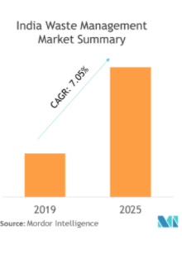
Market Analysis
Total Addressable Market | No. of people in India having smartphones = 760 millions(as per 2021) If every user renders us Rs.100 per month Total Addressable Market=12*100*76Cr=Rs.91200Cr
Industry Search trends | By 2025, the waste management market size in India is projected to be worth ~USD 15 Billion with annual growth around 7 percent
Percent of TAM in 5 yrs | We will work in Surat for 3 years(PPP with SMC), We would expand in Delhi(Waste Segregation done by us). TAM = 1440Cr % of TAM in 5 years= 1.57%
Industry Analysis

Slide 6
PROPOSED SOLUTION
An android application with Google lens integration in which user can scan the waste (the type of waste first gets identified, using additional Convolutional Neural networks added in Google lens) and as soon as the scanned waste gets identified user can place order to clean it ….our worker gets that place cleaned up within 2 hrs…..& the user gets some reward(cash prizes, etc.) for informing us about the waste.
The waste carried by the worker is segregated at source as wet,dry,menstrual using special bags having 3 side separation , the worker transports the dry waste (paper, cardboard,etc) using bus(BRTS) and the organic waste(excreta, vegetable pills,etc) is transported using e-rickshaws
Source Segregation and Collection
Large scale Segregation at Warehouses
Distribution of different waste to respective processing units

Slide 7
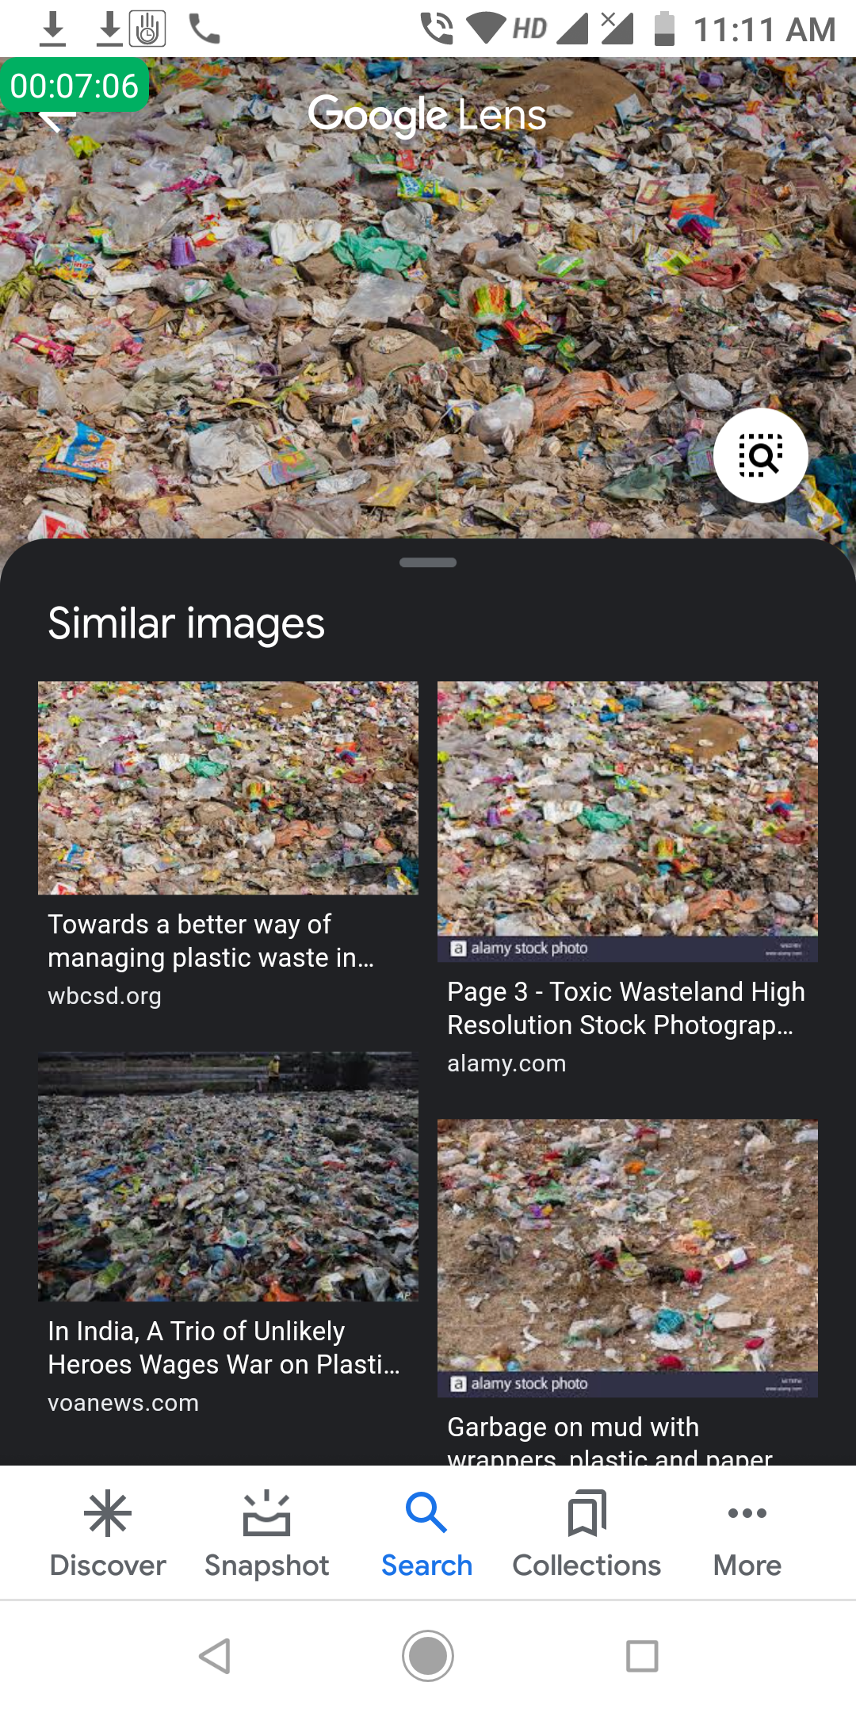
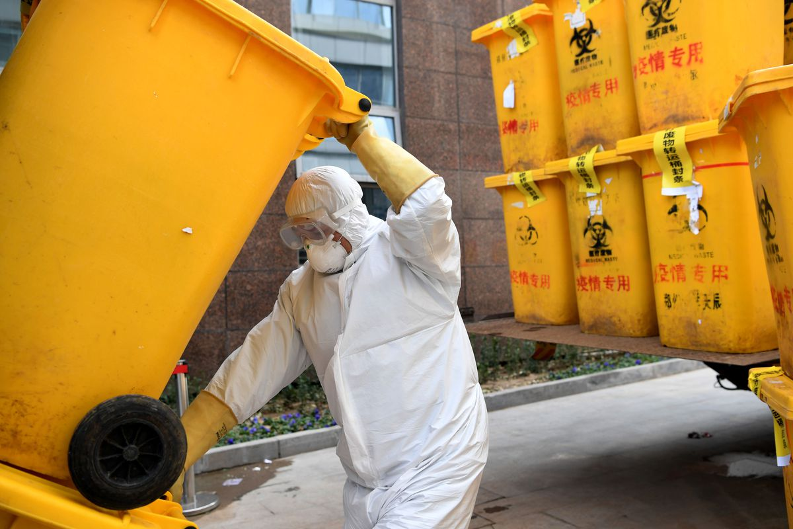
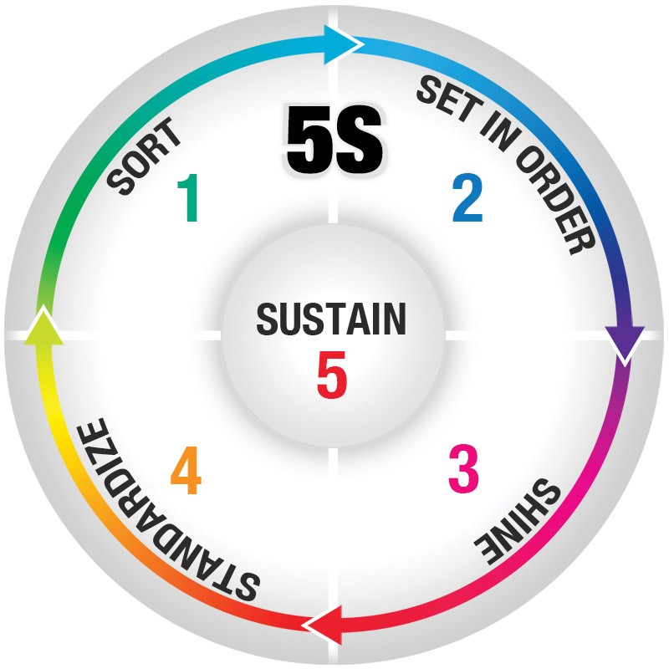

PROPOSED SOLUTION
All wastes reaches our warehouse (which we have rented) and workers do further segregation of waste (plastic,papers, cardboards, vegetable pills, electronic waste, hazardous waste, biomedical waste, sanitary napkins)
The waste segregated is transported by trucks to the waste plants….the waste plants gets us some money.
We will also collaborate with municipality (which are responsible & doing work on cleanliness)

Slide 8
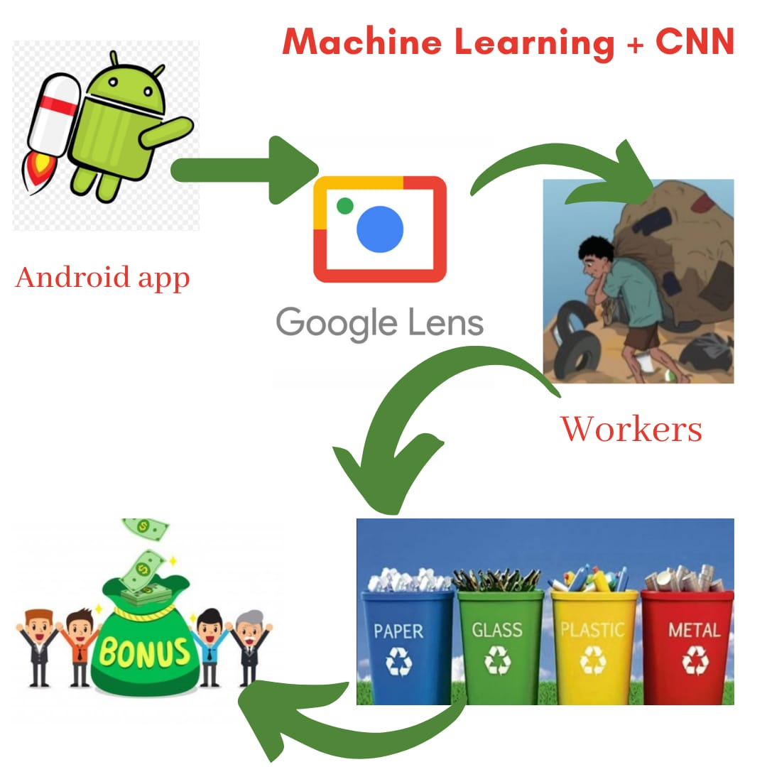
Future Prospects

Slide 9
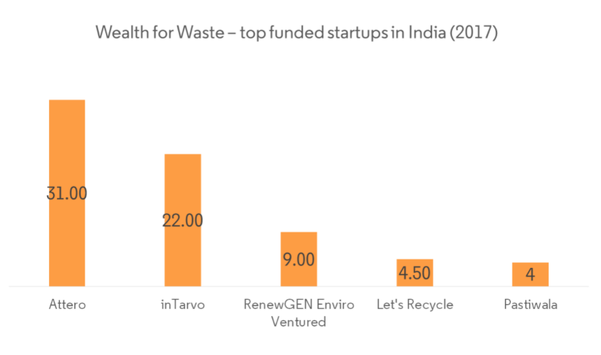
Competitors/Substitutes
Sampurn(e)arth Environment Solutions | Sampurn(e)arth Environment Solutions provides end-to-end decentralized waste management solutions for housing societies, corporate houses, townships, school and college campuses. Some of the major offerings of the enterprise include waste audits, designing of waste-management system, collection of dry waste from clients premises in exchange of customized recycled paper stationery, design, April 2017 / 14 implementation, operation and maintenance of biogas plants and composting/ vermicomposting pits
Let's Recyle | Let’s Recycle, which is an initiative of Nepra Resource Management collects and processes a range of materials. The enterprise also provides other waste management services including waste pick up along with customized waste management plan, disposal services, and fleet monitoring to provide the shortest route to Let's Recycle fleet to prevent CO2 emissions.
GreenNerds Solutions | Green Nerds integrates the waste value chain activities through technology for waste collection, waste recycling and compressing for landfill disposal. Its machines such as PECK kiosk and other compost processors use innovative technological appliances to recycle and compress solid waste for efficient disposal and management.
Indian Green Service | Indian Green Service (IGS) provides education and training support, treatment solutions such as vermicomposting, bamboo baskets and dry leave compost pits. IGS engages in public-private partnerships with local authorities and camps to create a large network of practitioners using its Zero Waste Management strategy

Slide 10
STRENGTHS
No. of Customers that can be acquired is huge
No other competitor works on collection of all the waste(Dry+Wet)
WEAKNESS
Profit margin is less
Need to operate in bulk to generate Revenue(If we do not collaborate with Government in that case)
OPPORTUNITY
The cleanliness of the city is ensured soon
People will be concious of not throwing wastes on roads and try giving it to us because in this case they are paid by us.
THREATS
The stray animals who used to find food in the roads will face problem.
Competitors may start to collect wet waste as well .

Slide 11
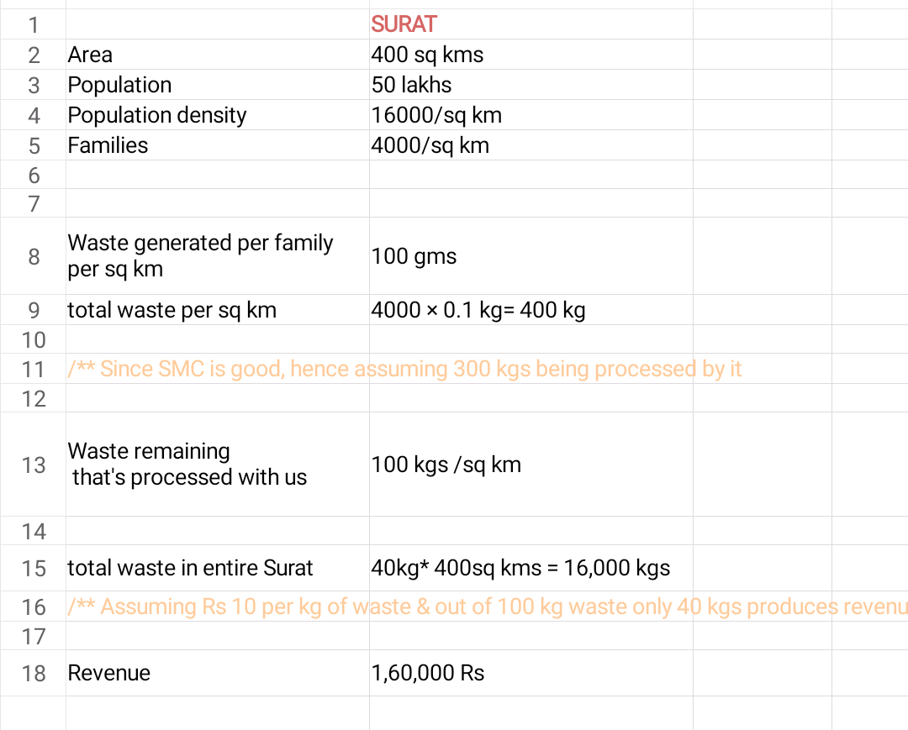
Example to show how this business can be profitable
For revenue generation, we need to collect waste in bulk amounts. (Since 1 kg of plastic ~~ Rs 12)
Workers expenses, rent of ware house, transportation expenses, application development and maintenance expenses…..:: Expenses.
Since SMC is quite responsible and is taking much proportion of our revenue by collecting waste, therefore we will pitch SMC for public private partnership….

Slide 12
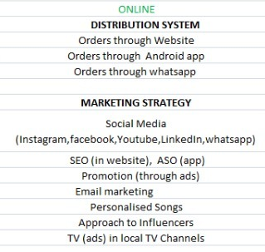
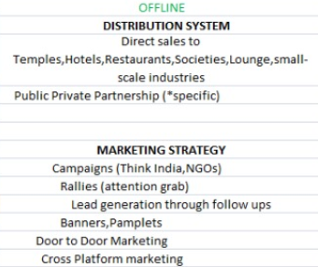
Go To Market Strategy

Slide 13
Work done till now
Website (Minimum Viable Product)
Android Application (Prototype)
Whatsapp Virtual Chatbot (Prototype)
We are all set to approach SMC for Public Private Partnership (App development and maintenance, marketing, customer acquisition, employees’ training, feedback resolution will be done by us and SMC would give us money and Garbage Vans’ rights.)

Slide 14
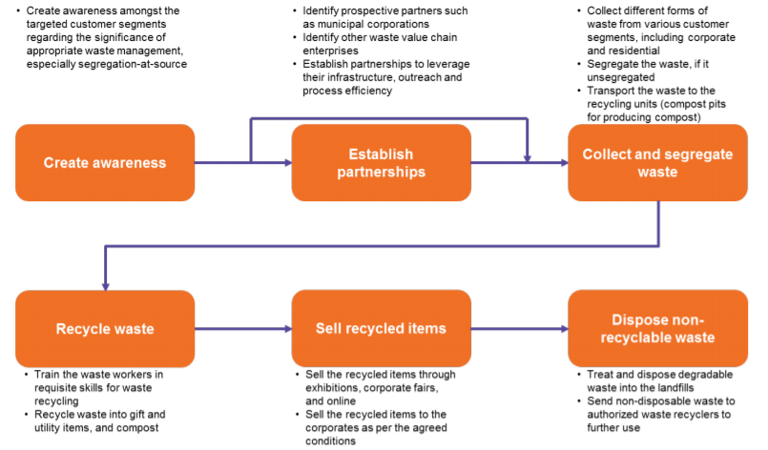
ACTION PLAN
In The First couple years we will collaborate with SMC in Public Private Partnership
in which we will take help from SMC for garbage collection and transportation.
Then we will move to Delhi as a private company, we will do everything on our own.

Slide 15
Jobs created
Active
The Core Team
Workers in the Warehouses for segregation of waste
Workers for transportation from Door to Warehouse
Passive
For SMC Collaboration, interns for application development and maintenance
The cleanliness workers (who are already working under some private agency or govt) will get a passive source of income

Slide 16
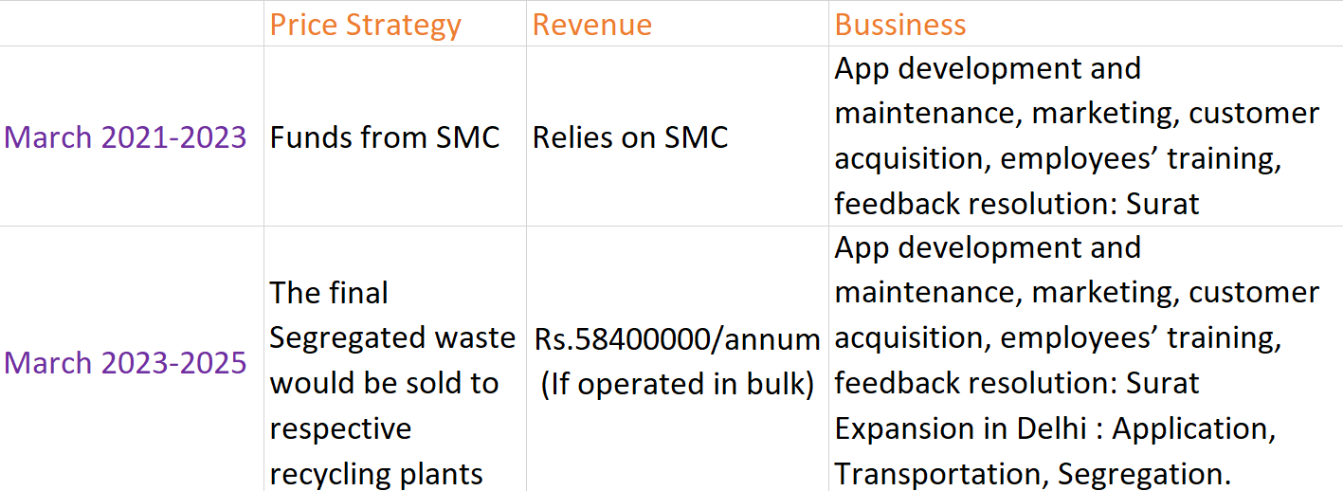
Forecasting

Slide 17
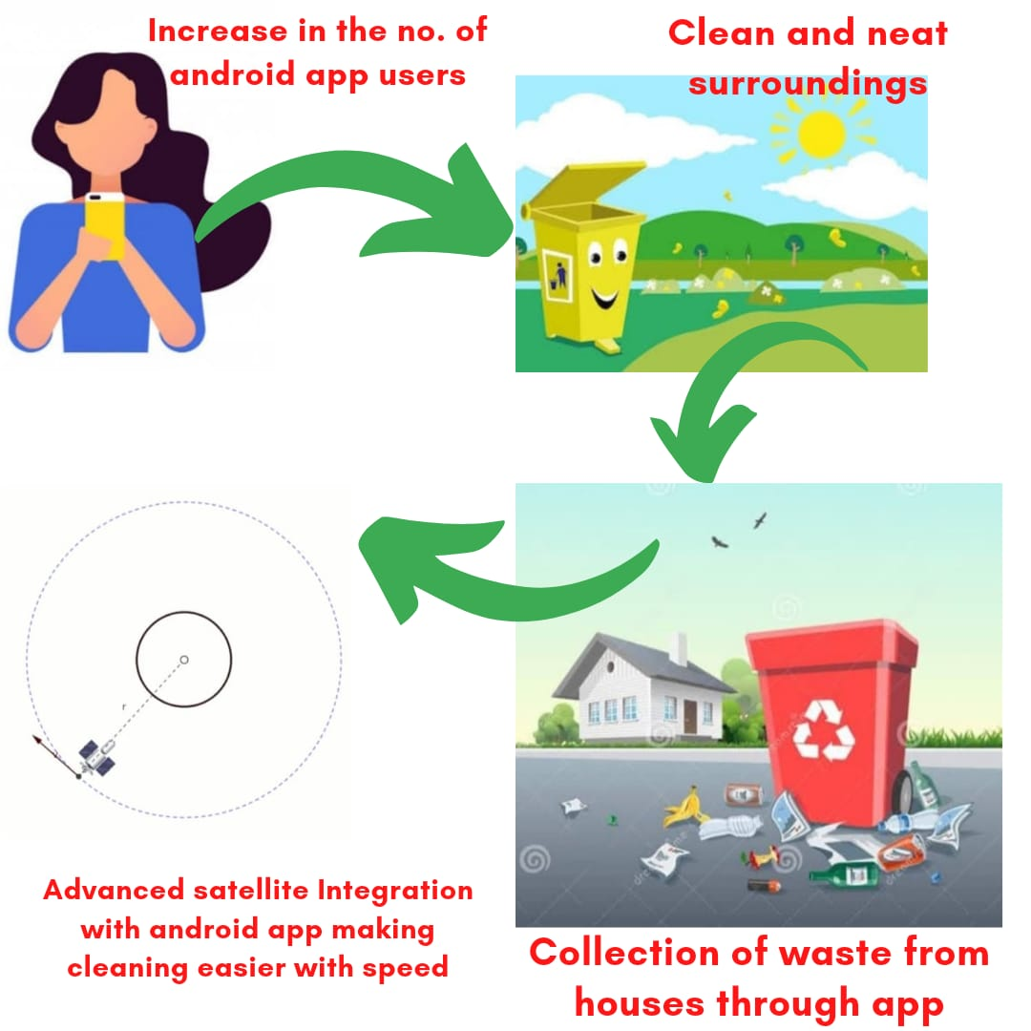
Future aspects and scope in Indian market
- When people will get used to application, than all the scattered waste in public places will get eliminated soon,...slowly people will began to scan their household waste instead of throwing it in drains.
- When our application will grow than we will work on :;: that user can track real time waste in 1 km radius around him
(Using Advanced satellite integration in our app) ...not only user will be able to clean places around him but surroundings also.

Slide 18
Thank you
Contact us:. k.cleanliness.drive@gmail.com

